Slide 1
Impact Analysis of Airbnb on Housing Across the United States
10/18/2022
Capstone: Fall 2022
Inside Airbnb
Team 1: Venkata Naga Sai Kumar Bysani, Nandita Krishnan, Feisheng Qin, Brett Sexton, Vishwa Srivastava

Slide 2
Airbnb Impacts Housing in Some Areas of the US
Airbnb, although intended to be used for renting out spare rooms, is often used in ways that are not consistent with the concept of “home-sharing” and this is negatively impacting residential communities, particularly those that have low rates of home ownership and low rates of rental vacancies, in addition to high concentrations of airbnb rentals and increasing rental prices.
Residents and policy makers are now working against rising rental rates, high rates of displacement, and low rental availability, which creates a need for tools that are capable of helping users of Inside Airbnb to make their own decisions about the impact Airbnb has on their communities.

Slide 3
Overview of Project Progress at Midterm
Objective | Weight | Status | Overall Completion
Highlight the areas of high risks and low risks | 25% | C | 80%
Identify how communities that are experiencing high concentrations of Airbnb properties are impacted by the phenomenon | 20% | IP
Analyze the incentive to provide a short term rental vs. long term rental | 20% | C
Review the metrics on evictions and how they may be related to Airbnb conversion | 5% | NS
Construct a time-series analysis to determine the change in rental prices relative to the concentration of Airbnb properties | 5% | NS
Build tools/dashboard that help users visualize Airbnb’s presence on residential communities | 25% | IP

Slide 4
Dictionary of Important Metrics
Metric | Calculated or Given? | Formula | Explanation | Objectives
Airbnb Density | Calculated | # of Airbnb’s / Total Housing Units | The concentration of airbnb properties relative to total housing units. | 1, 5
Vacancy Rate | Given | NA | The number of vacant and available housing units relative to total housing units. | 1
# of Vacant & Available to Rent Units | Given | NA | The number of vacant and available to rent housing units. | 1
Ownership Rate | Calculated | Owner Occupied/Total Housing Units | Owner occupied housing units relative to total housing units. | 1
Median Contract Rent / % Change in Median Contract Rent | Given / Calculated | [(Median Rent (2021) - Median Rent (2022)) / Median Rent (2021)] * 100 | The median rent paid in a rental contract / the change in a percentage value seen from 2021 to 2022. | 1, 5
LTR Density | Calculated | # of LTR / # of Airbnb’s | The concentration of LTR airbnb properties (min nights < 30 nights) relative to total airbnb units. | 3
STR Density | Calculated | # of STR /# of Airbnb’s | The concentration of STR airbnb properties (min nights < 30 nights) relative to total airbnb units. | 3
Monetary Incentive | Calculated | Avg Revenue (STR) - Avg Revenue (LTR) | The average revenue difference between a short term rental and a long term rental. | 3
Gross Rent as a Percentage of Income | Given | NA | The percentage of household income going into paying rent. | 2

Slide 5
Utilizing an Objective-Based Methodology
Highlight the areas
of high and low risk:
Identify how communities are impacted by the phenomenon:
Analyze the incentive to provide a STR vs. LTR:
Review the metrics on evictions and how they may be related to Airbnb conversion:
Construct a time-series analysis to determine the change in rental prices relative to the Airbnb density.
-We have based our risk methodology on the logic that there is an affordability and supply risk where the airbnb density is high, vacancy rate is low, ownership rate is low, and median contract rent is increasing.
-These four metrics will be utilized to calculate a weighted risk score and a percentile cutoff to place the larger geographies into categories of risk.
-Additionally, due to data limitations, we will be employing a more simple risk calculation technique for the more granular geographies using the ratio of Airbnb’s to Vacant and Available Units.
-Once the areas have been labeled with a risk score, the areas of interest that have fall into “high risk” can be analyzed more closely to determine more specific areas of impact.
-We plan to look at metrics like: % of Income going into Rent, Rates of Homelessness, and Eviction Rates.
-To analyze the monetary incentive, we have utilized the occupancy model to determine the estimated revenue for each Airbnb and then grouped the listings into short-term rentals and long-term rentals to determine the average revenue of each group in different geographic areas. -The differential will be used to determine if there is a monetary incentive for one type of rental over the other.
-In addition to showing evictions as a possible indirect impact of Airbnb in high risk areas, we also want to analyze the data to determine if there is evidence of evictions being caused by a desire to list a property as an Airbnb.
-We will look into this by constructing a time series plot with correlation statistics that shows the number of evictions vs the number of the new airbnb properties within a given time frame and geography.
-We will be utilizing Zillow data to get more complete and accurate rental price data.
-Then, we will utilize our calculated metric for airbnb density.
-The two will be plotted in time-series format to show, by geography, the change over time that has occurred to the two metrics.
-The plots will then be analyzed to determine how consistent the movement of the two metrics are when compared.

Slide 6
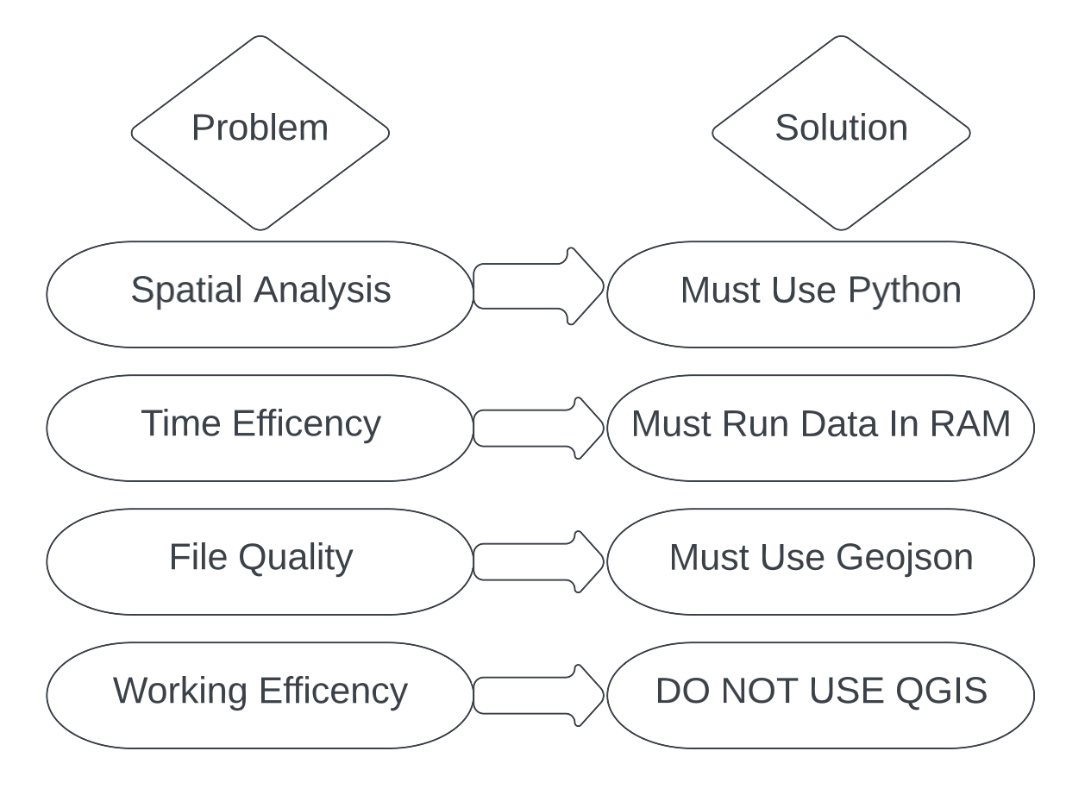
Overcoming the Problems Faced When Attempting Reverse Geocoding
The calculation capacity of computer is a big problem when doing Reverse Geocoding, especially when there are hundreds of shape files.
Our solution will split a single calculation process into multiple calculation processes and use a light size file format.

Slide 7
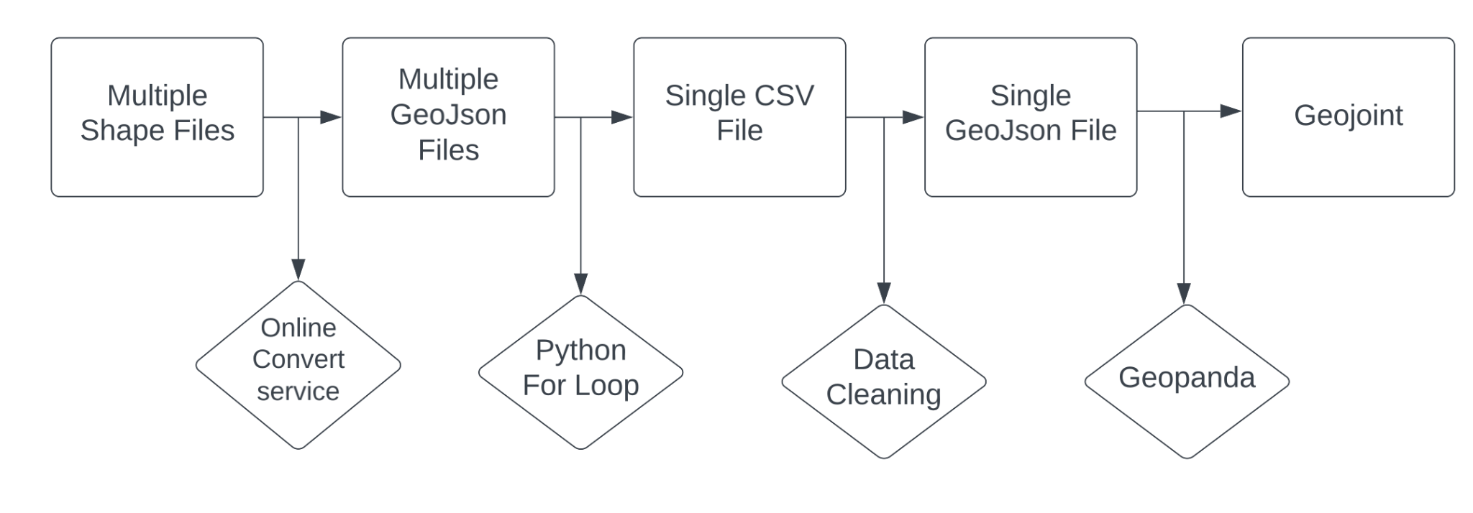
Our Approach to Reverse Geocoding
Our Work Stream
Geo information in the listing.csv is latitude and longitude, this is called the Exact Location.
Reverse Geocoding is the the process of converting latitude, longitude to a readable geography.
Online Reverse Geocoding Service is very expensive and can cost anywhere from $1,200 -$1,600.

Slide 8
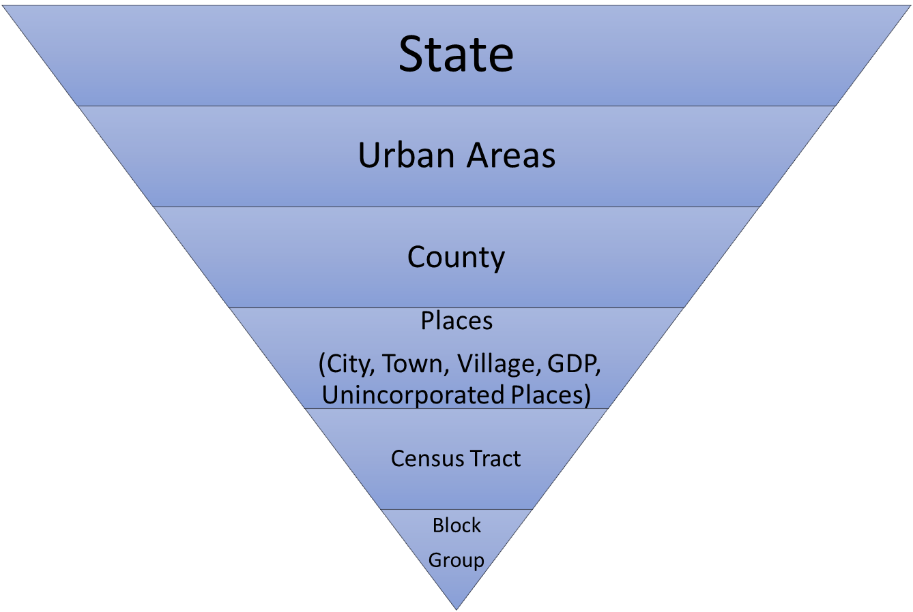
Users Can Drill Down into 6 Levels of the Geographic Hierarchy
Other Available Geographies
Zip Codes

Slide 9
Creating a Metric for Risk
Logic Followed to Determine Risk
Calculation Procedure
Geographies that have low housing ownership rate and low rental vacancy rate are states with high risk.
Additionally, geographies that have high Airbnb density and high % change in median contract rent are also at high risk.
*Due to data limitations, we are plotting the areas that we have data for and exploring solutions for the missing/null metric values.
Rank the geographies across the 4 parameters one 1,2,3 or 5 points. The lowest point was awarded to the factors that create highest risk to the housing community.
Sum individual scores across the 4 parameters for all geographies and then calculate aggregate final score.
Geographies with lowest score are geographies at risk and vice versa
The risk metrics allow us to identify geographies at high and low risk across various geographical hierarchy levels. For e.g. a high risk state can have more granular geographies (county, zip, etc.) that may be a high and low risk within that specific state.
Notes:
Nandita

Slide 10
Tableau Prototypes
Risk Dashboard
Incentive Dashboard
Risk Rating assigned to States & Counties generated using the weighted sum of the following metrics derived from the Inside Airbnb data in combination with the Census Data:
Airbnb Density
Rental Vacancy
Ownership Rates
Percent change in MCR
Revenue generated through short-term rentals (less than 30 days min stay) vs. long-term rentals (30+ days min stay) - calculated by implementing the Occupancy Model that utilizes Number of Reviews to estimate demand
Incentive to rent out an Airbnb short-term rental vs. long-term rental, at all geographical levels ranging from State to Block Groups
The dashboards displaying the monetary incentive involved in renting out a property as an Airbnb, as well as the risk and economic impact caused by presence of an Airbnb in some areas, with the option of viewing the analyses on multiple geographical levels, make our prototypes flexible and user-friendly for residents and policymakers.
Notes:
Nandita

